Slide 1
FortiGate Security
Application Control
FortiOS 7.2
Notes:
In this lesson, you will learn how to monitor and control network applications that may use standard or non-standard protocols and ports—beyond simply blocking or allowing a protocol, port number, or IP address.

Slide 2
Application Control Basics
Application Control Configuration
Best Practices and Troubleshooting
Logging and Monitoring Application Control Events
Notes:
In this lesson, you will learn about the topics shown on this slide.

Slide 3
Application Control Basics
Understand application control
Detect types of applications
Understand the FortiGuard application control services database
Use application control signatures
Notes:
After completing this section, you should be able to achieve the objectives shown on this slide.
By demonstrating competence in application control basics, you will be able to understand how application control works on FortiGate.

Slide 4




What Is Application Control and How Does It Work?
Detects and acts on network application traffic
  Such as Facebook, Skype, Gmail, LogMeIn, and so on
  Supports many applications and categories, including P2P and proxy
  Can scan secure protocols
    Requires SSL/SSH inspection profile in the firewall policy
How does it work?
  Uses the IPS engine
  Uses flow-based scan (not proxy-based)
  Compares traffic to known application patterns
    Only reports packets that match an enabled pattern
    Can detect even if users try to circumvent through an external proxy
Notes:
Application control detects applications—often applications that consume a lot of bandwidth—and allows you to take appropriate action related to application traffic, such as monitoring, blocking, or applying traffic shaping.
Application control identifies applications, such as Google Talk, by matching known patterns to the application’s transmission patterns. Therefore, an application can be accurately identified, only if its transmission pattern is unique. However, not every application behaves in a unique way. Many applications reuse pre-existing, standard protocols and communication methods. For example, many video games, such as World of Warcraft, use the BitTorrent protocol to distribute game patches.
Application control can be configured in proxy-based and flow-based firewall policies. However, because application control uses the IPS engine, which uses flow-based inspection, inspection is always flow-based. By comparison, when applying web filtering and antivirus through an HTTP proxy, the proxy first parses HTTP and removes the protocol, and then scans only the payload inside.
Why does FortiGate use a flow-based scan for application control?
Unlike other forms of security profiles, such as web filtering or antivirus, application control is not applied by a proxy. It uses an IPS engine to analyze network traffic and detect application traffic, even if the application is using standard or non-standard protocols and ports. It doesn’t operate using built-in protocol states. It matches patterns in the entire byte stream of the packet, and then looks for patterns.

Slide 5


Detecting Peer-to-Peer Applications
Why is peer-to-peer (P2P) traffic so difficult to detect?
  Traditional protocols (HTTP, FTP) have a client-server architecture
    It uses a single server with large bandwidth for many clients
    It requires predictable port numbers, NAT/PAT, and firewall policies
  Peer-to-peer protocols (BitTorrent, Skype) have a distributed architecture
    Each peer is a server with small bandwidth to share
    They are difficult to manage multiple firewall policies to block them
    They do not depend on port forwarding
    They use evasive techniques to bypass these limitations
Notes:
When HTTP and other protocols were designed, they were designed to be easy to trace. Because of that, administrators could easily give access to single servers behind NAT devices, such as routers and, later, firewalls.
But when P2P applications were designed, they had to be able to work without assistance—or cooperation—from network administrators. In order to achieve this, the designers made P2P applications able to bypass firewalls and incredibly hard to detect. Port randomization, pinholes, and changing encryption patterns are some of the techniques that P2P protocols use.
These techniques make P2P applications difficult to block using a firewall policy, and also make them difficult to detect by proxy-based inspection.
Flow-based inspection using the IPS engine can analyze packets for pattern matching, and then look for patterns to detect P2P applications.

Slide 6
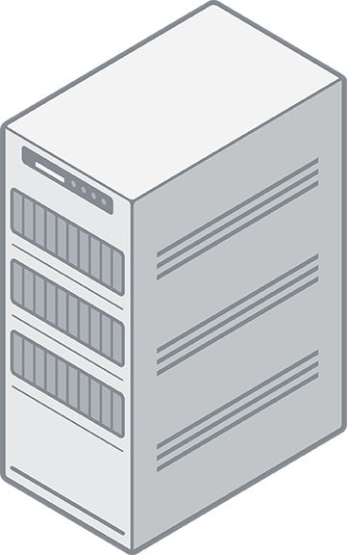
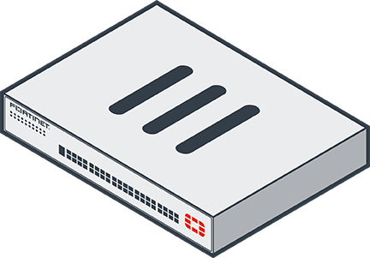


Client-Server Architecture
Traditional download
  One client
  One server
  Known port number
  Easily blocked by firewall policies
Notes:
This slide shows a traditional, client-server architecture. There may be many clients of popular sites, but often, such as with an office file server, it’s just one client and one server.
Traditional downloads use a defined protocol over a standard port number. Whether it’s from a web or FTP site, the download is from a single IP address, to a single IP address. So, blocking this kind of traffic is easy: you only need one firewall policy.
But, it’s more difficult to block traffic from peer-to-peer downloads. Why?

Slide 7

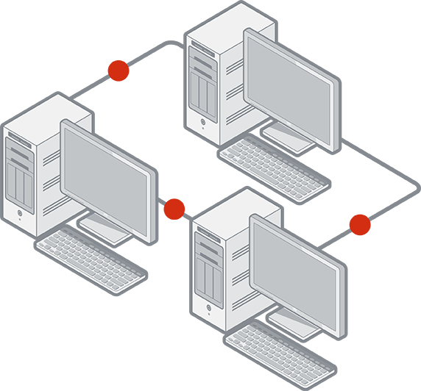



Peer-to-Peer Architecture
Peer-to-peer (P2P) download
  One client
  Many servers
  Dynamic port numbers
  Optionally, dynamic encryption
  Hard to block with traditional firewalls
    Requires more sophisticated scanning
Notes:
Peer-to-peer (P2P) downloads divide each file among multiple (theoretically unlimited) peers. Each peer delivers part of the file. While having many clients is a disadvantage in client-server architectures, it is an advantage for P2P architecture because, as the number of peers increases to n, the file is delivered n times faster.
Because popularity increases the speed of delivery—unlike traditional client-server architecture where popularity could effectively cause a denial of service (DoS) attack on the server—some software, such as BitTorrent distributions of Linux, and games distributing new patches, leverage this advantage. Even if each client has little bandwidth, together they can offer more bandwidth for the download than many powerful servers.
Consequently, in order to download the file, the requesting peer can consume much more bandwidth per second than it would from only a single server. Even if there is only one peer in your network, it can consume unusually large amounts of bandwidth. Because the protocols are usually evasive, and there will be many sessions to many peers, they are difficult to completely block.

Slide 8
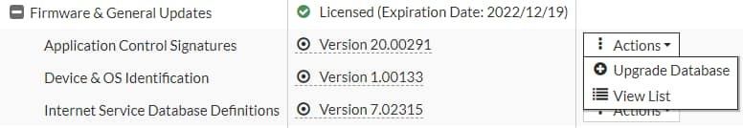
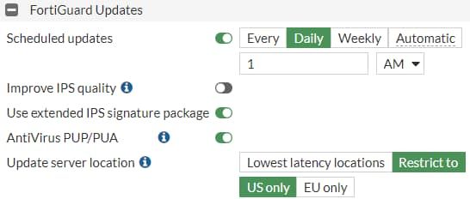
Application Control Signatures
Application control requires a FortiGuard subscription for database updates
  The database of application control signatures is separate from the IPS database.
System > FortiGuard
Currently installed application control database version
Forcing FortiGate to check for latest updates
System > FortiGuard
Configuring scheduled updates
Notes:
Before you try to control applications, it’s important to understand the signatures used by application control.
How does application control detect the newest applications and changes to application protocols?
Application control updates come as part of the standard FortiCare support contract, but it requires a subscription for database updates. The database for application control signatures is separate from the intrusion prevention system (IPS) database. You can configure FortiGate to automatically update its application control signature database on the FortiGuard page. The application control signature database information is also displayed on the FortiGuard page.

Slide 9
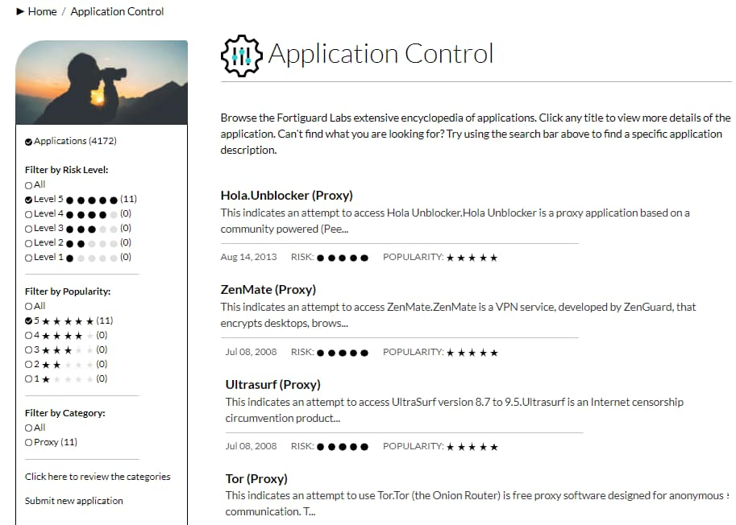
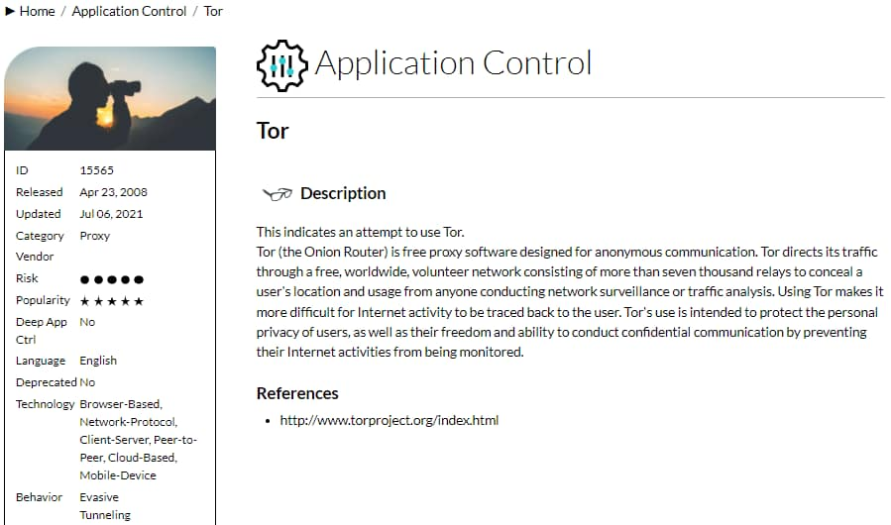
Application Control Database
You can view complete list of applications supported by FortiGuard application control on https://fortiguard.com/
  You can review the application category or request a signature for a new application from the same website.
Refine search using filters
Notes:
You can view the latest version of the application control database on the FortiGuard website, or by clicking an individual application signature in the application control profile.
The application control database provides details about application control signatures based on category, popularity, and risk, to name a few.
When building an application control signature, the FortiGuard security research team evaluates the application and assigns a risk level based on the type of security risk. The rating is Fortinet-specific, and not related to the common vulnerability scoring system (CVSS) or other external systems. The rating can help you decide whether or not to block an application.
On the FortiGuard website, you can read details about each signature’s related application.
This slide shows an example for an application called Tor. Tor is a web proxy, so it belongs in the proxy category. A best practice is to create test policies that you can use to observe policy behavior.
If the most recent FortiGuard update does not include a definition for an application that you need to control, you can submit a request on the FortiGuard website to have the application added. You can also submit a request to re-evaluate an application category, if you believe an application should belong to a different category.

Slide 10
Hierarchical Structure
Application control signatures are organized in a hierarchical structure
  The parent signature takes precedence over the child signature
Requires Certificate Inspection
Social Media
Audio/Video
Requires Deep Inspection
Facebook
LinkedIn
YouTube
Facebook_Chat
Facebook_Apps
LinkedIn_Message
YouTube_Video.Play
Notes:
Many web applications offer functionality that can be embedded in third-party websites or applications. For example, you can embed a Facebook Like button at the end of an article, or reference a YouTube video on an educational website. FortiOS gives administrators all the tools they need to inspect sub-application traffic. The FortiGuard application control signature database is organized in a hierarchical structure. This gives you the ability to inspect the traffic with more granularity. You can block Facebook applications while allowing users to collaborate using Facebook chat.

Slide 11

Which statement about application control is true?
  Application control uses the IPS engine to scan traffic for application patterns.
  Application control is unable to scan P2P architecture traffic.
Which statement about the application control database is true?
  The application control database is separate from the IPS database.
  The application control database must be updated manually.

Slide 12
Application Control Basics
Application Control Configuration
Best Practices and Troubleshooting
Logging and Monitoring Application Control Events
Notes:
Good job! You now understand basic application control functionality.
Now, you will learn about application control configuration.

Slide 13
Application Control Configuration
Configure application control in profile mode
Configure application control in next generation firewall (NGFW) policy mode
Use the application control traffic shaping policy
Notes:
After completing this section, you should be able to achieve the objectives shown on this slide.
By demonstrating competence in configuring the application control operation modes that are available on FortiOS, you will be able to use application control effectively in both profile mode and NGFW policy mode.

Slide 14
Application Control Profiles
Configured when FortiGate NGFW mode is set to profile-based
Uses flow-based scanning techniques in both inspection modes
Allows you to filter application traffic based on:
  Categories
    Similar applications are grouped together
    Can view application control signatures for that category
    Can configure actions for predefined categories
  Application overrides
    Allows you to configure actions for specific signatures or applications
  Filter overrides
    Provides a more flexible way to create application categorization based on behavior, popularity, protocol, risk, and so on
Must be applied to a firewall policy
Notes:
When FortiGate or a VDOM is operating in flow-based (NGFW mode set to profile-based, policy set to flow-based) inspection mode or policy set to proxy-based inspection mode, to configure application control, administrators must create an application control profile and apply that profile to a firewall policy.
It is important to note that the application control profile uses flow-based scanning techniques, regardless of which inspection mode is used on the policy.
The application control profile consists of three different types of filters:
Categories: Groups applications based on similarity. For example, all applications that are capable of providing remote access are grouped in the Remote Access category. You can view the signatures of all applications in a category or apply an action to a category as a whole.
Application overrides: Provides the flexibility to control specific signatures and applications.
Filter overrides: Useful when a predefined category does not meet your requirements and you want to block all applications based on criteria that is not available in categories. You can configure the categorization of applications based on behavior, popularity, protocol, risk, vendor, or the technology used by the applications, and take action based on that.

Slide 15
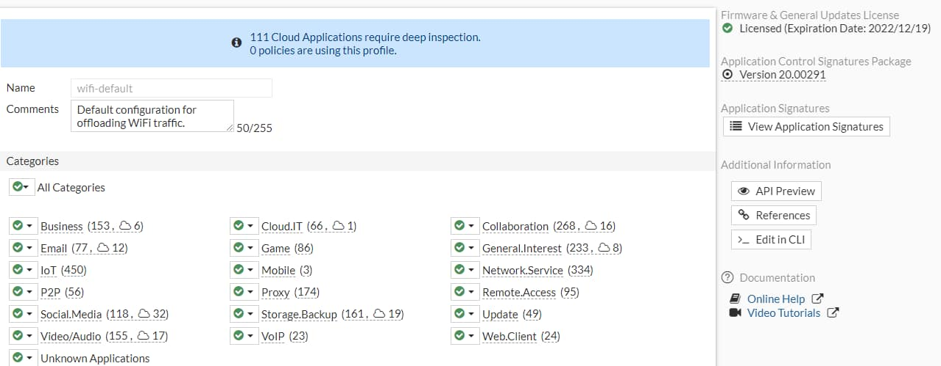
Configuring an Application Control Profile
The application control profile is available only when NGFW mode is set to profile-based inspection mode
Security Profiles > Application Control
Displays list of application control signatures
Applies an action to all categories at once
Matches traffic to unidentified applications
Notes:
The application control profile is configured on the Application Control page. You can configure actions based on categories, application overrides, and filter overrides. You can also view the list of application control signatures by clicking View Application Signatures.
At the top of the Application Control profile page, you will see a summary of how many cloud applications require deep inspection. Cloud applications that use SSL encryption cannot be scanned without a deep inspection profile. FortiGate must decrypt the traffic in order to perform inspection and control application traffic.
The Unknown Applications setting matches traffic that can’t be matched to any application control signature and identifies the traffic as unknown application in the logs. Factors that contribute to traffic being identified as unknown application include:
How many rare applications your users are using
Which IPS database version you are using
Identifying traffic as unknown can cause frequent log entries. Frequent log entries decrease performance.

Slide 16
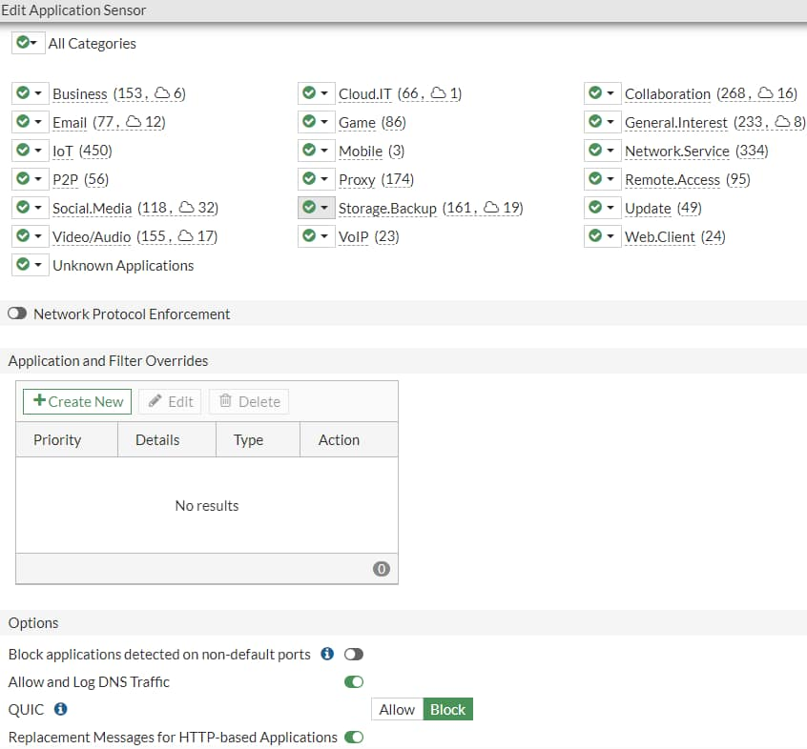
Configuring Additional Options
Application control profiles include additional options that you can configure
Security Profiles > Application Control
The number to the right of the cloud symbol indicates the number of cloud applications in the category
Notes:
The number listed to the right of the cloud symbol indicates the number of cloud applications in the category.
Allow and Log DNS Traffic: Enable this option to allow DNS traffic for the application sensor. Depending on the application and how often it queries DNS servers, enabling this setting can use significant system resources.
QUIC: QUIC is a protocol from Google that uses UDP Instead of the standard TCP connections for web access. UDP is not scanned by web filtering. Allowing QUIC instructs FortiGate to inspect Google Chrome packets for a QUIC header and to generate logs as QUIC messages. Blocking QUIC forces Google Chrome to use HTTP2/TLS1.2 and FortiGate to log QUIC as blocked. The default action for QUIC is Block.
Replacement Messages for HTTP-based Applications: This setting allows you to replace blocked content from HTTP/HTTPS applications with an explanation for the user’s benefit. For non-HTTP/HTTPS applications, FortiGate only drops the packets or resets the TCP connection.
After you’ve configured the application control profile, select the profile in the firewall policy. Like any other security profile, the settings you configure in the application control profile are not applied globally. FortiGate applies the application control profile settings only to traffic governed by the firewall policy in which you’ve selected the application control profile. This allows granular control.

Slide 17
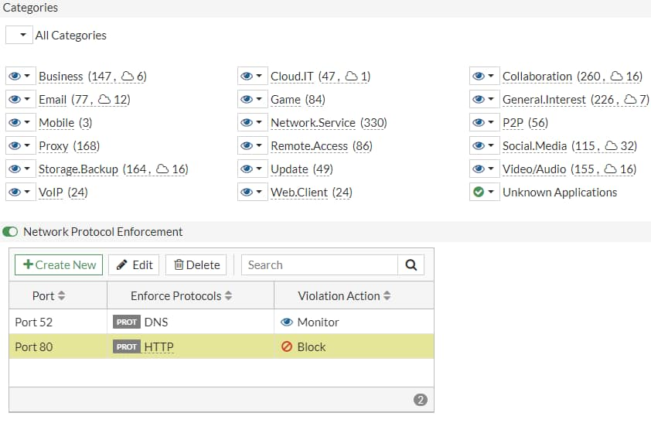
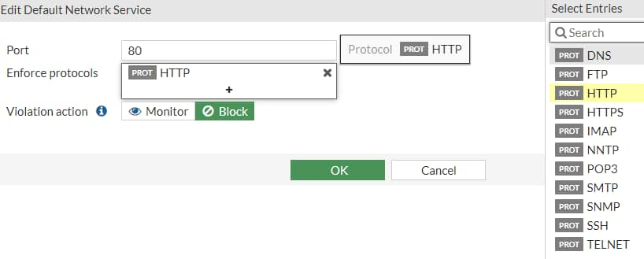
Protocol Enforcement
Allows blocking or monitoring of known services on unknown ports
Security Profiles > Application Control
List of known services
Notes:
Protocol enforcement is added to the application control profile, allowing the administrator to configure network services (for example, FTP, HTTP, and HTTPS) on known ports (for example, 21, 80, and 443), while blocking those services on other ports.
The feature takes action in the following scenarios:
When one protocol dissector confirms the service of network traffic, protocol enforcement can check whether the confirmed service is whitelisted under the server port. If it is not, then the traffic is considered a violation and IPS can take the action (for example, block) specified in the configuration.
There is no confirmed service for network traffic. It would be considered a service violation if IPS dissectors rule out all the services enforced under its server port. For example, if port 21 is configured for FTP and IPS Dissector could not decide on the exact service but is sure it is not FTP. If the port of the non-ftp traffic is 21, it will be a violation.

Slide 18
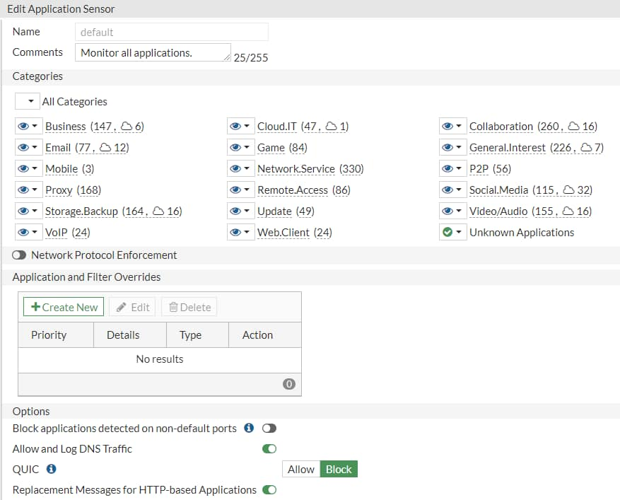
Scanning Order
Security Profiles > Application Control
The IPS engine identifies the application
The application control profile scans for matches in this order:
  Application and filter overrides
  Categories
2
1
Notes:
The IPS engine examines the traffic stream for a signature match.
Then, FortiGate scans packets for matches, in this order, for the application control profile:
Application and filter overrides: If you have configured any application overrides or filter overrides, the application control profile considers those first. It looks for a matching override starting at the top of the list, like firewall policies.
Categories: Finally, the application control profile applies the action that you’ve configured for applications in your selected categories.

Slide 19
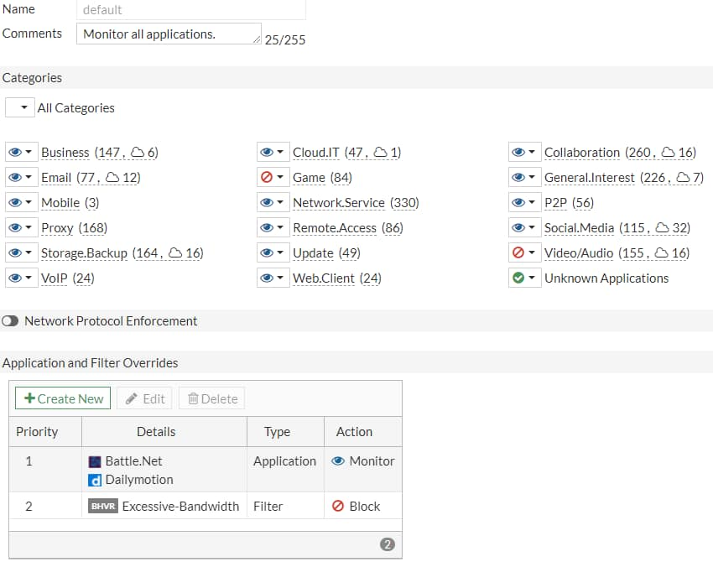
Order of Scan and Blocking Behavior (Scenario 1)
Application Overrides: Battle.Net and Dailymotion applications are set to Monitor
Filter Overrides: Excessive bandwidth consuming applications are set to Block
  Contains applications from different categories – BitTorrent (P2P), Adobe.Update (Update), FaceTime (VOIP), Flickr (Social.Media)
Categories: The Game and Video/Audio categories are set to Block and all other categories are set to Monitor
Security Profiles > Application Control
3
1
2
Notes:
In the example profile shown on this slide, the application control profile blocks the Game and Video/Audio categories. For applications in these categories, FortiGate responds with the application control HTTP block message. (It is slightly different from the web filtering HTTP block message.) All other categories are set to Monitor, except Unknown Applications, and are allowed to pass traffic.
In the Application and Filter Overrides section, you can see that some exceptions are specified. Instead of being set to Block, Battle.Net (Game) and Dailymotion (Video/Audio) are set to Monitor. Because application overrides are applied first in the scan, these two applications are allowed, and generate logs.
Next, the scan checks for Application and Filter Overrides. Because a filter override is configured to block applications that use excessive bandwidth, it blocks all applications using excessive bandwidth, regardless of categories that allow these applications.
This slide shows an example of how several security profile features could work together, overlap, or work as substitutes, on the same traffic.
After the application control profile scan is done, FortiGate begins other scans, such as web filtering. The web filtering scan could block Battle.Net and Dailymotion, but it would use its own block message. Also, web filtering doesn’t check the list of application control overrides. So, even if an application control override allows an application, web filtering could still block it.
Similarly, static URL filtering has its own exempt action, which bypasses all subsequent security checks. However, application control occurs before web filtering, so that the web filtering exemption cannot bypass application control.

Slide 20
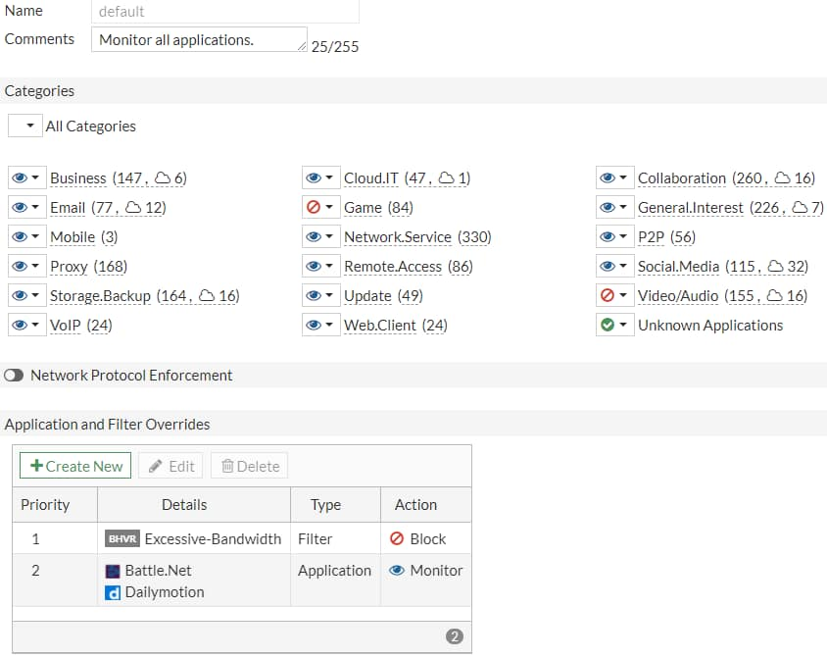
Order of Scan and Blocking Behavior (Scenario 2)
Filter Overrides: Excessive bandwidth consuming applications are set to Block
  Contains applications from different categories – BitTorrent (P2P), Adobe.Update (Update), FaceTime (VOIP), Flickr (Social.Media)
Application Overrides: Battle.Net and Dailymotion applications are set to Monitor
Categories: The Game and Video/Audio categories are set to Block and all other categories set to Monitor
Security Profiles > Application Control
3
1
2
Notes:
In the example profile shown on this slide, the filter override has been moved above the application override. In this scenario, the filter override (Excessive-Bandwidth) is blocked and, since Dailymotion falls under the excessive bandwidth category, Dailymotion is blocked even though it is set to Monitor under the Application and Filter Overrides section.
The priority in which application and filter overrides are placed takes precedence.

Slide 21
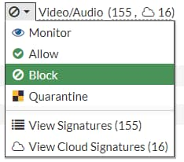
Actions
Allow
  Continue to next scan or feature and do not log
Monitor
  Allow but log
    Good for the initial study of your network traffic
Block
  Drop packets and log
Quarantine
  Block and log traffic from attacker IP address until the expiration time
    Can set duration to days, hours, or minutes
View the list of signatures of native or cloud applications for a specific category
Notes:
For each filter in the application control profile, you must indicate an action—what FortiGate does when traffic matches. Actions include the following:
Allow: Passes the traffic and does not generate a log
Monitor: Passes the traffic, but also generates a log message
Block: Drops the detected traffic and generates a log message
Quarantine: Blocks the traffic from an attacker IP until the expiration time is reached and generates a log message
The View Signature action allows you to view signatures from a particular category only and is not a configurable action. The View Cloud Signatures action allows you to view application signatures for cloud applications from a particular category.
Which is the correct action to choose?
If you’re not sure which action to choose, Monitor can be useful initially, while you study your network. Later, after you have studied your network traffic, you can fine-tune your filter selection by choosing the most appropriate action. The action you choose also depends on the application. If an application requires feedback to prevent instability or other unwanted behavior, then you might choose Quarantine instead of Block. Otherwise, the most efficient use of FortiGate resources is to block.

Slide 22
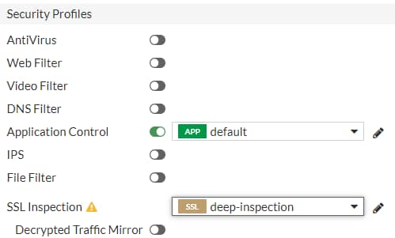
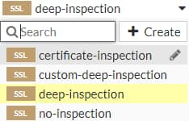
Applying an Application Control Profile
You must apply the Application Control profile on a firewall policy to scan the passing traffic
  You must also select SSL/SSH Inspection profile
Use deep-inspection profile to scan encrypted traffic
Policy & Objects > Firewall Policy
Notes:
After you configure an application control profile, you must apply it to a firewall policy. This instructs FortiGate to start scanning application traffic that is subject to the firewall policy.

Slide 23
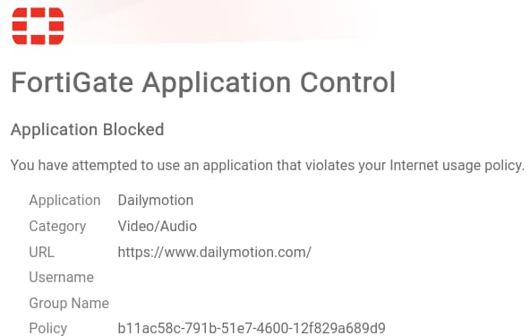
Block Page
Application control in profile mode displays similar HTTP block pages
HTTP block page includes:
  Category
  Website host and URL
  User name (if authentication is enabled)
  Group name (if authentication is enabled)
  Policy UUID
Notes:
For HTTP-based applications, application control can provide feedback to the user about why their application was blocked. This is called a block page, and it is similar to the one you can configure for URLs that you block using FortiGuard web filtering.
It is also worth mentioning that, if deep inspection is enabled in the firewall policy, all HTTPS-based applications provide this block page.
The block page contains the following information:
Signature that detected the application (in this case, Dailymotion)
Signature’s category (Video/Audio)
URL that was specifically blocked (in this case, the index page of www.dailymotion.com), since a web page can be assembled from multiple URLs
User name (if authentication is enabled)
Group name (if authentication is enabled)
UUID of the policy governing the traffic
The last item in this list can help you to identify which policy on FortiGate blocked the page, even if you have a large number of policies with many FortiGate devices securing different segments.

Slide 24
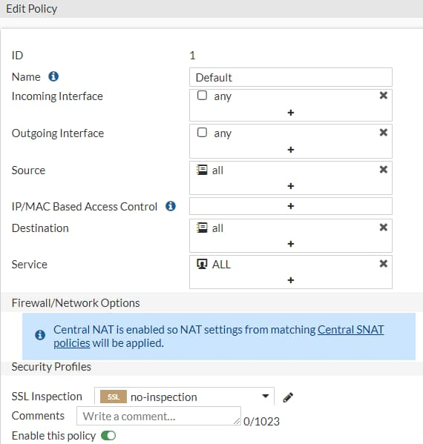
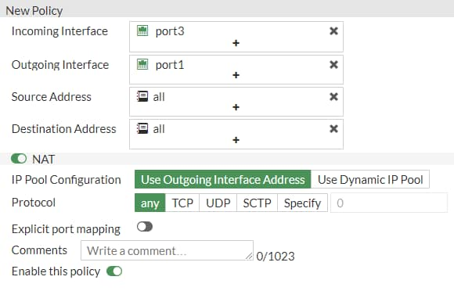
NGFW Policy-Based Mode
Available in flow-based inspection mode only
Application control is configured directly on the security policy
  Cannot configure application control profile
Must select SSL inspection profile on an SSL Inspection & Authentication (consolidated) policy
Requires the use of central SNAT policy
Policy & Objects > SSL Inspection & Authentication
Policy & Objects > Central SNAT
Notes:
When FortiGate is operating in NGFW policy-based mode, administrators can apply application control to a security policy directly, instead of having to create an application control profile first, and then apply that to a firewall policy. Eliminating the need to use an application control profile makes it easier for the administrator to select the applications or application categories they want to allow or deny in the firewall policy.
It is important to note that all security policies in an NGFW policy-based mode VDOM or FortiGate must specify an SSL/SSH inspection profile on a consolidated policy. NGFW policy-based mode also requires the use of central source NAT (SNAT), instead of NAT settings applied within the firewall policy.

Slide 25
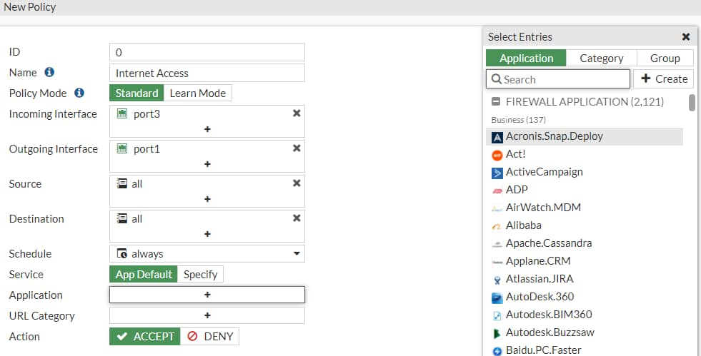
NGFW Policy-Based Mode (Contd)
You can select applications, application categories, or groups directly on a security policy
You can apply the ACCEPT or DENY actions to allow or block selected application traffic
If a URL Category is set, then applications that you add to the policy must be within the browser-based technology category
You can apply the AntiVirus and IPS security profiles to a security policy with the action set to ACCEPT
Policy & Objects > Security Policy
List is searchable
Notes:
You can select one or more applications, application groups, and application categories on a security policy in the Application section. After you click the + icon for an application, a pop-up window opens. In that window, you can search for and select one or more application signatures, application groups, or application categories. Based on the applications, groups, and application categories applied to the policy, FortiOS applies the security action to the application traffic.
You can configure the URL Category within the same security policy; however, adding a URL filter causes application control to scan applications in only the browser-based technology category, for example, Facebook Messenger on the Facebook website.
You can also configure the Group with multiple applications and application categories. This allows the administrator to mix multiple applications and categories.
In addition to applying a URL category filter, you can also apply AntiVirus and IPS security profiles to application traffic that is allowed to pass through.

Slide 26
How Does NGFW Policy-Based Filtering Work?
It is a three-step process:
  Step 1–Allow all applications until they can be identified:
    Uses only the IPv4 header information to match the policy
    Accepts the traffic
    Creates an entry in the session table with the may_dirty flag
    Forwards all the packets to the IPS engine for inspection
  Step 2–As soon as the IPS engine identifies the application, it adds the following to the session:
    dirty flag - instructs the kernel to re-evaluate session entry
    app_valid flag - indicates that IPS engine has validated the traffic
    Application ID
  Step 3–The dirty flag instructs the kernel to look up the security policy again:
    This time the kernel uses the Layer 4 headers and the Layer 7 information to match the traffic
    The action configured in the security policy is applied to the identified application traffic
Notes:
FortiOS uses a three-step process to perform NGFW policy-based application filtering. Here is a brief overview of what happens at each step.
In step 1, FortiOS allows all traffic while forwarding packets to the IPS engine for inspection and identification of the traffic. At the same time, FortiOS creates an entry in the session table allowing the traffic to pass and it adds a may_dirty flag to it.
In step 2, as soon as the IPS engine identifies the application, it updates the session entry with the following information: dirty flag, app_valid flag, and an application ID.
In step 3, the FortiOS kernel performs a security policy lookup again, to see if the identified application ID is listed in any of the existing security policies. This time the kernel uses both Layer 4 and Layer 7 information for policy matching. After the criteria matches a firewall policy rule, the FortiOS kernel applies the action configured on the security policy to the application traffic.

Slide 27
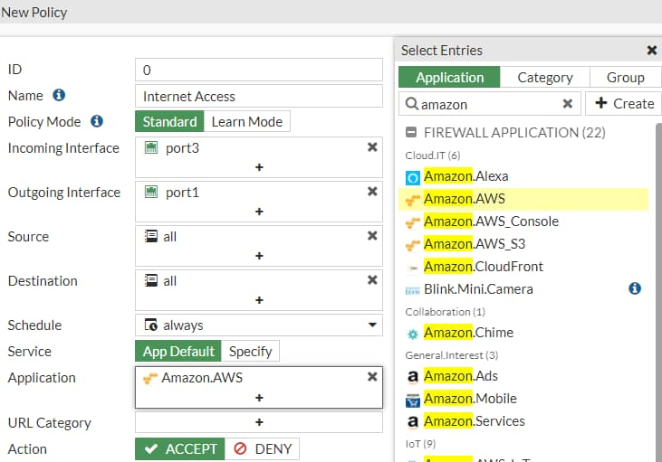
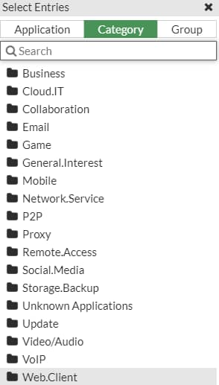
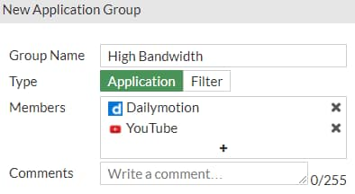
Configuring App Control in Policy-Based Mode
Policy & Objects > Security Policy
Notes:
Configuring application control in NGFW policy-based mode is simple. You can create a new security policy or edit an existing security policy. In the Application section, select the applications, categories, or groups that you want to allow or deny, and change the security policy Action accordingly. For applications that you selected to allow, you can further enhance network security by enabling antivirus scanning and IPS control. You can also enable the logging of Security Events or All Sessions to ensure that all application control events are logged.

Slide 28
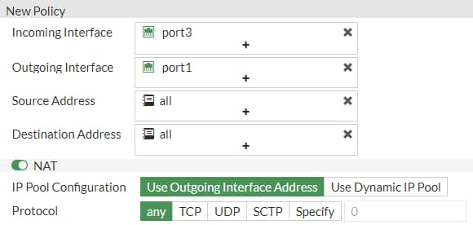
Policy-Based Central SNAT Policy
Policy & Objects > Central SNAT
Policy & Objects > SSL Inspection & Authentication
Notes:
You must have a matching central SNAT policy in NGFW policy-based mode to be able to pass traffic. FortiGate applies NAT on the traffic based on the criteria defined in the central SNAT policy.
It is extremely important to arrange security policies in Policy & Objects, so that the more specific policies are located at the top to ensure proper use of application control.
A default SSL Inspection & Authentication policy inspects traffic accepted by any of the security firewalls, and by using the certificate-inspection SSL inspection profile.

Slide 29
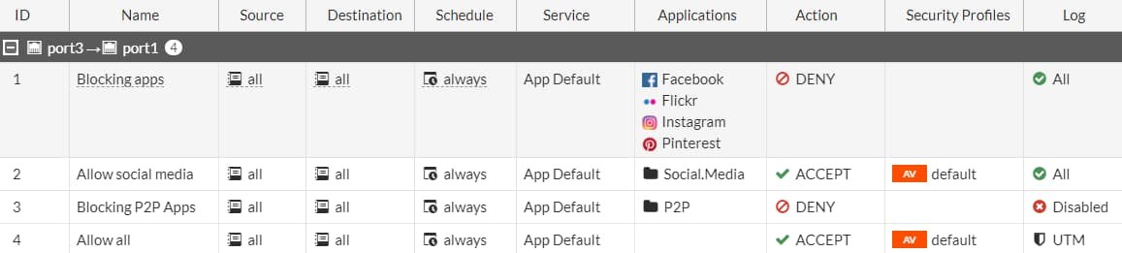
NGFW Policy Matching
Based on the configuration shown in the screenshot:
  Facebook, Flickr, Instagram, and Pinterest application traffic is blocked by policy ID 1
  All other Social.Media (for example, LinkedIn) application traffic is allowed by policy ID 2
  All applications that belong to the P2P application category are blocked by policy ID 3
  All other traffic and applications are allowed by policy ID 4
Policy & Objects > Security Policy
Notes:
NGFW policy matching works using a top-to-bottom approach. You must have a specific policy above a more broad or open policy. For example, if you would like to block Facebook but allow the Social.Media category, you must place the policy blocking Facebook traffic above the policy allowing the Social.Media category.

Slide 30

Application Control Traffic Shaping
Other applications: 136Kbps
Granular control of bandwidth usage
Some traffic can’t be distinguished by port number/IP
  Example: YouTube video URLs—don’t say whether it is a text comment or a video https://www.youtube.com/watch?v=eO2vyJDoP3M
Only traffic that matches the signature is shaped
  Won’t interfere with other apps on same port/protocol
  Useful for managing bandwidth-intensive apps
Total: 1,536 Kbps
Video: 1,400Kbps
Notes:
If an application is necessary, but you must prevent it from impacting bandwidth then, instead of blocking it entirely, you can apply a rate limit to the application. For example, you can rate limit applications used for storage or backup leaving enough bandwidth for more sensitive streaming applications, such as video conferencing.
Applying traffic shaping to applications is very useful when you’re trying to limit traffic that uses the same TCP or UDP port numbers as mission-critical applications. Some high-traffic web sites, such as YouTube, can be throttled in this way.
Examine the details of how throttling works. Not all URL requests to www.youtube.com are for video. Your browser makes several HTTPS requests for:
The web page itself
Images
Scripts and style sheets
Video
All of these items have separate URLs. If you analyze a site like YouTube, the web pages themselves don’t use much bandwidth; it is the video content that uses the most bandwidth. But, since all content is transported using the same protocol (HTTPS), and the URLs contain dynamically generated alphanumeric strings, traditional firewall policies can't block or throttle the traffic by port number or protocol because they are the same. Using application control, you can rate limit only videos. Doing this prevents users from saturating your network bandwidth, while still allowing them to access the other content on the site, such as for comments or sharing links.

Slide 31
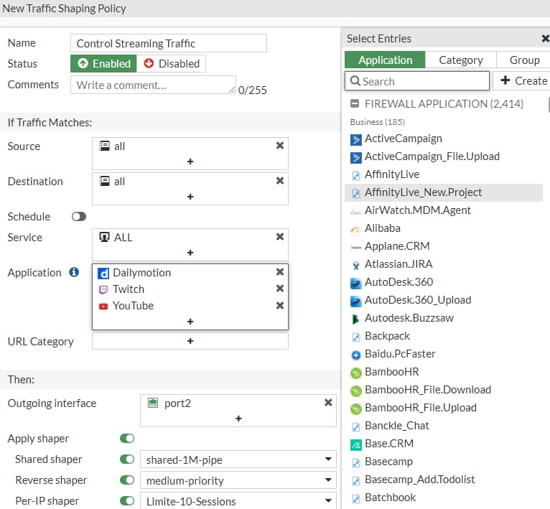
Configuring the Traffic Shaping Policy
Must ensure matching criteria aligns with the settings in your firewall policy
    Firewall policy must allow the traffic that you wish to control bandwidth of
Can shape traffic for application control based on:
  Application category
  Application
  Application group
Policy & Objects > Traffic Shaping > Traffic Shaping Policies
Used for web filtering
Notes:
You can limit the bandwidth of an application category, application group, or specific application by configuring a traffic shaping policy. You can also apply traffic shaping to FortiGuard web filter categories and to the application group.
You must ensure that the matching criteria aligns with the firewall policy or policies to which you want to apply shaping. It does not have to match outright. For example, if the source in the firewall policy is set to all (0.0.0.0/0.0.0.0), you can set the source in the traffic shaping policy to any source that is included in all, for example, LOCAL_SUBNET (10.0.1.0/24).
If the traffic shaping policy is not visible in the GUI, you can enable it on the Feature Visibility page.
There are two types of shapers that you can configure on the Traffic Shaping Policy page, and you can apply them in the traffic shaping policy:
Shared shaper: applies a total bandwidth to all traffic using that shaper. The scope can be per policy or for all policies referencing that shaper.
Per-IP shaper: applies traffic shaping to all source IP addresses in the security policy. Bandwidth is equally divided among the group.
Note that the outgoing interface is usually the egress interface (WAN). The Shared shaper setting is applied to ingress-to-egress traffic, which is useful for restricting bandwidth for uploading. The Reverse Shaper setting is also a shared shaper, but it is applied to traffic in the reverse direction (egress-to-ingress traffic). This is useful for restricting bandwidth for downloading or streaming, because it limits the bandwidth from the external interface to the internal interface.

Slide 32
Which statement about application control in an NGFW policy-based configuration is true?
  Applications are applied directly to the security policies.
  The application control profile must be applied to firewall policies.
Which statement about the HTTP block page for application control is true?
  It can be used only for web applications.
  It works for all types of applications.

Slide 33
Application Control Basics
Application Control Configuration
Logging and Monitoring Application Control
Best Practices and Troubleshooting
Notes:
Good job! You now understand application control configuration.
Now, you will learn about logging and monitoring application control events.

Slide 34
Logging and Monitoring Application Control
Enable application control logging events
Monitor application control events
Use FortiView to see a detailed view of application control logs
Notes:
After completing this section, you should be able to achieve the objectives shown on this slide.
By demonstrating competence in application control configuration, including reviewing application control logs, you will be able to effectively use and monitor application control events.

Slide 35
Enabling Application Control Logging
Example of NGFW policy-based mode firewall policies
All attempts to access these applications are blocked and logged
Policy & Objects > Security Policy
Access to P2P applications are blocked; however attempts are not be logged
Notes:
Regardless of which operation mode application control is configured in, you must enable logging on the security or firewall policy. When you enable the logging of security events or all sessions on a security or firewall policy, application control events are also logged. You must apply application control to the security or firewall policy to enable application control event logging.
When the Deny action is selected on a security or firewall policy, you must enable the Log Violations option to generate application control events for blocked traffic.

Slide 36
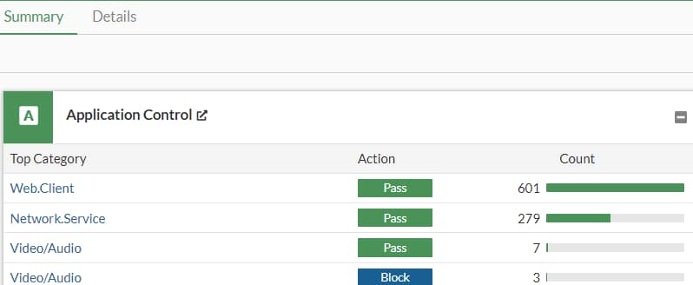
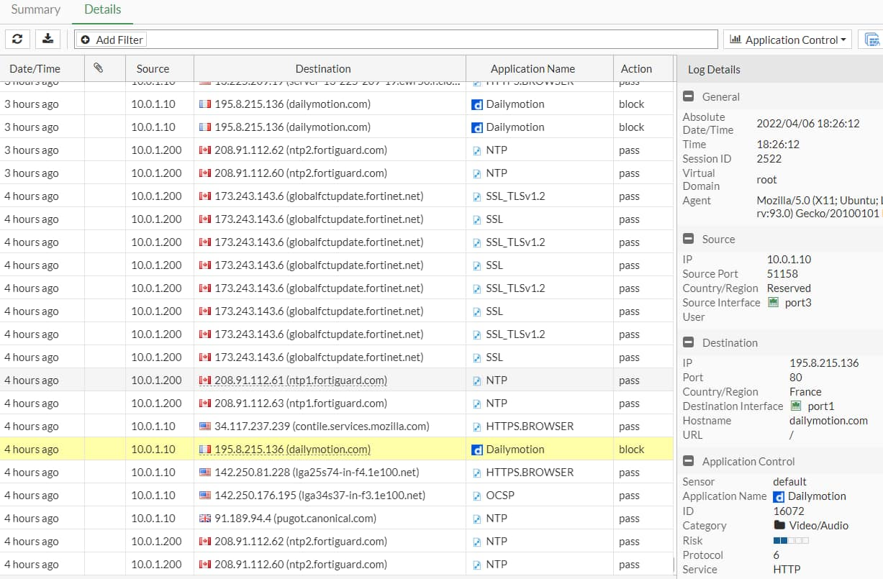
Logging Application Control Events
FortiGate logs all application control events on the Security Events pane on the Log & Report page
Log & Report > Security Events
Notes:
FortiGate logs all application control events on the Security Events pane on the Log & Report page. You can view the logs by clicking on Application Control.
In the example shown on this slide, the default application control profile blocks access to Dailymotion. You can view this information in the Log Details section, as well as information about the log source, destination, application, and action.
Note that application control generates this log message using a profile-based configuration. The log message for an NGFW policy-based configuration, does not include information that does not apply, such as application sensor name. The remainder of the information and structure of the log message is the same for each log, regardless of which inspection mode FortiGate is using.
You can also view the details on the Forward Traffic logs pane, where firewall policies record activity. You can also find a summary of the traffic to which FortiGate applied application control. Again, this is because application control is applied by a firewall policy. To find out which policy applied application control, you can review either the Policy ID or the Policy UUID fields of the log message.

Slide 37
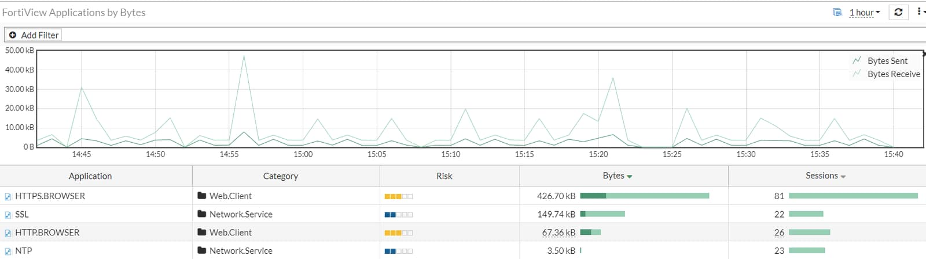
Application Control Events In Dashboard View
Application control events are saved in a standalone dashboard on the Top Applications dashboard
  Requires disk logging
Dashboard >Top Applications
Notes:
On the Dashboard menu, the Top Applications standalone page provides details about each application, such as the application name, category, and bandwidth. You can drill down further to see more granular details by double-clicking an individual log entry. The detailed view provides information about the source, destination, policies, or sessions for the selected application.

Slide 38
Where do you enable logging of application control events?
  Application control logs are enabled in the firewall policy configuration.
  Application control logs are enabled on the FortiView Applications page of FortiGate.
Which piece of information is not included in the application event log when using NGFW policy-based mode?
  Application control profile name
  Application name

Slide 39
Application Control Basics
Application Control Configuration
Logging and Monitoring Application Control Events
Best Practices and Troubleshooting
Notes:
Good job! You now understand application control logging and monitoring.
Now, you will learn about application control best practices and troubleshooting.

Slide 40
Best Practices and Troubleshooting
Recognize best practices for application control configuration
Understand how to troubleshoot application control update issues
Notes:
After completing this section, you should be able to achieve the objectives shown on this slide.
By demonstrating competence in application control best practices and troubleshooting, you will be able to configure and maintain an effective application control solution.

Slide 41
Best Practices for Application Control
Apply application control to only the traffic that requires it
  Specify subnets (source, destination, or both) within the firewall policy, whenever possible
  Don’t apply application control to internal-to-internal traffic
If using load balancing or failover internet connections, apply identical application control on all load balancing or redundant firewall policies
Select Deep-Inspection instead of Certificate-based inspection as the SSL/SSH inspection method
Use a FortiCloud account to save and view application control events in FortiView
  FortiGate devices that don’t have an internal disk for logging require FortiCloud logging to use FortiView
Use hardware acceleration for application signature matching
Notes:
This slide lists some best practices to keep in mind when implementing application control on FortiGate.
Not all traffic requires an application control scan. Don’t apply application control to internal-only traffic.
To minimize resource use on FortiGate, be as specific as possible when creating firewall policies. This reduces resource use, and also helps you build a more secure firewall configuration.
Create identical firewall policies for all redundant internet connections, to ensure that the same inspection is performed on failover traffic. Select Deep-Inspection instead of Certificate-based inspection for the SSL/SSH inspection mode, to ensure content inspection is performed on encryption protocols.
FortiGate models that feature specialized chips, such as network processors and content processors, can offload and accelerate application signature matching for enhanced performance.
You can use a FortiCloud account to save and view application control logs in FortiView, on FortiGate devices that do not have a log disk.

Slide 42
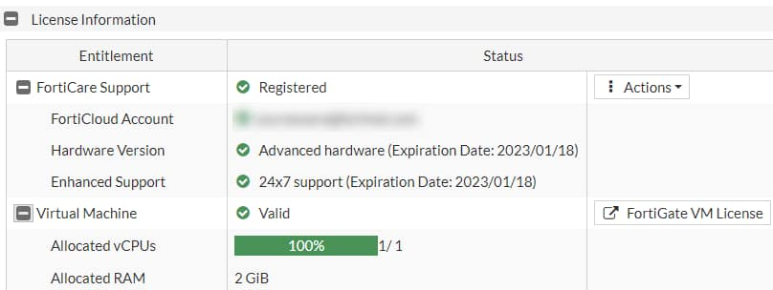
Application Control Troubleshooting
If FortiGuard has update issues, make sure that:
  FortiGate has a stable connection to the internet
  FortiGate is able to resolve DNS (update.fortiguard.net)
  TCP port 443 is open
Force FortiGate to check for new application control updates:
Verify that the application control signatures database version is up-to-date with the FortiGuard website
execute update-now
System > FortiGuard
Notes:
If you are experiencing issues with a FortiGuard application control update, start troubleshooting the issue with the most basic steps:
Make sure that FortiGate has a stable connection to the internet or FortiManager (if FortiGate is configured to receive updates from FortiManager)
If the internet connection is stable, check DNS resolution on FortiGate
If FortiGate is installed behind a network firewall, make sure that port443 is being allowed from FortiGate
You can check the FortiGuard website for the latest version of the application control database. If your locally installed database is out-of-date, try forcing FortiGate to check for the latest updates by running the execute update-now command.

Slide 43
Which protocol does FortiGate use with FortiGuard to receive updates for application control?
  UDP
  TCP
Which SSL/SSH inspection method is recommended for use with application control scanning to improve application detection?
  Certificate-based inspection profile
  Deep-inspection profile

Slide 44
Application Control Basics
Application Control Configuration
Logging and Monitoring Application Control Events
Best Practices and Troubleshooting
Notes:
Congratulations! You have completed this lesson.
Now, you’ll review the objectives that you covered in this lesson.

Slide 45
Understand application control
Detect types of applications
Understand FortiGuard application control services
Use application control signatures
Configure application control in profile mode
Configure application control in NGFW policy mode
Use the application control traffic shaping policy
Enable application control logging events
Monitor application control events
Use the dashboard to see a detailed view of application control logs
Recognize best practices for application control configuration
Understand how to troubleshoot application control update issues
Notes:
This slide shows the objectives that you covered in this lesson.
By mastering the objectives covered in this lesson, you learned how to use methods beyond simply blocking protocols, port numbers, or IP addresses, to monitor and control both standard and non-standard network applications.

